Slide 1
Earthquakes

Slide 2
By the end of this Smart Lesson, you should be able to:
1. Explain why earthquakes occur;
2. Compare P-waves and S-waves;
3. Interpret a seismogram.

Slide 3
An earthquake is a sudden release of energy from under the ground.
That energy travels through the ground as distortions called seismic waves. These waves cause shaking; the more energy is released, the stronger the shaking!
Detecting and recording seismic waves allows geologists to study the earthquakes that created them. Understanding them is important for science as well as safety.

Slide 4
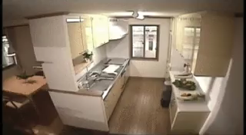

Slide 5
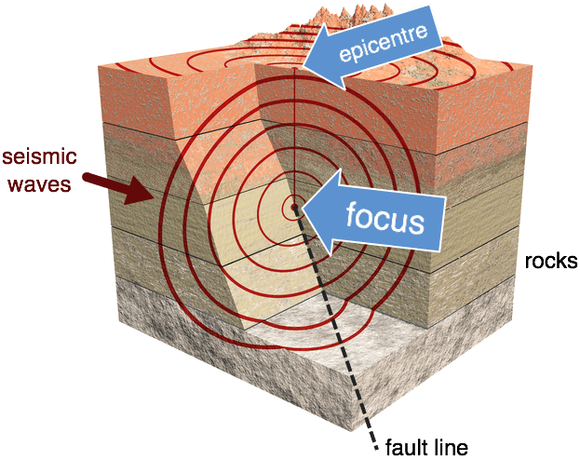
Seismic waves travel in all directions from a point called the focus.
Sometimes the focus is also referred to as the hypocentre of an earthquake. It's the centre of the shaking!
The point on the Earth's surface directly above the focus is known as the epicentre. From a bird's eye view, seismic waves appear to move in circles out from this point.

Slide 6
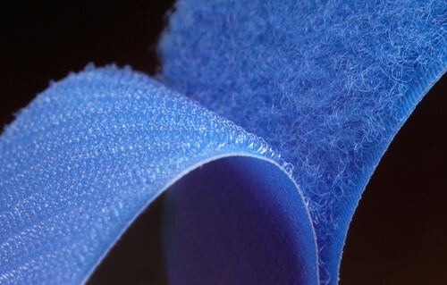
Earthquakes occur along fault lines associated with tectonic plate boundaries.
At the boundary between two tectonic plates, friction normally stops the plates from sliding freely. However, the plates are still 'trying' to move and they put huge amounts of strain on the rocks at the boundary.

Slide 7
Energy travels through the Earth, or across its surface, as seismic waves.
Scientists use instruments called seismometers to detect and record these waves.

Slide 8
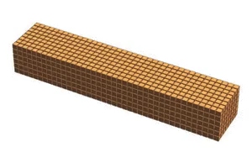
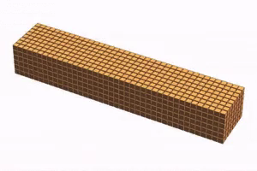
Seismic waves come in two main types: P-waves and S-waves.
P-waves are longitudinal, like sound waves. As they pass through a material, they cause that material to stretch and squash repeatedly, like an accordion.
S-waves are transverse, like ripples on water. They cause solid materials to wiggle from side to side, or up and down.
P-wave | S-wave

Slide 9
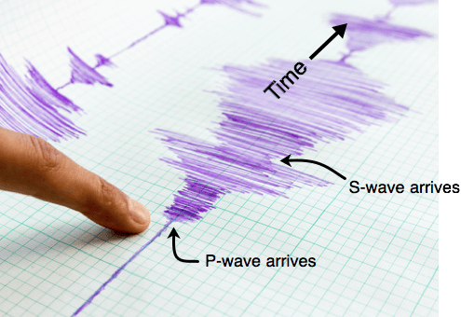
P-waves travel through the Earth faster than S-waves.
This means that P-waves are recorded by seismometers before the S-waves are.
It also means P-waves can warn us of incoming S-waves, which tend to do more damage to structures on the ground. The arrival of the P-waves a few seconds earlier gives people time to shelter under their desks or in doorways.

